Slide 1
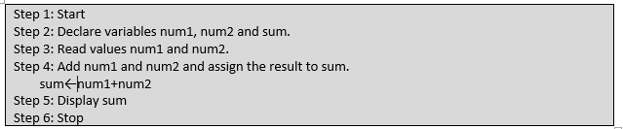
Pseudocode
Program to add two numbers enter by user

Slide 2
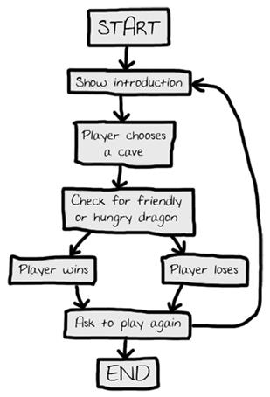
Another Flow Chart Example

Slide 3
Pseudocode
Step 1: Start
Step 2: read variables, num 1, num 2 and total
Step 3: Calculate Sum
Step 4: display the total
Step 5: end

Slide 4
Your Solution Here
start
Num1, num2, sum
Decision
Sum= Num1 + num 2
Sum
stop

